Slide 1

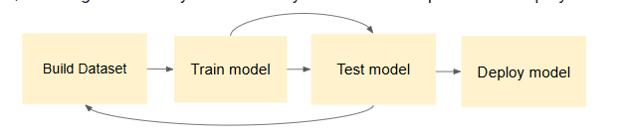

Teacher PD Supplemental Resources: Machine Learning Pipeline
Overview
Living and Working with Artificial Intelligence
Developed for the AI4GA (Artificial Intelligence for Georgia) project funded by National Science Foundation awards DRL-2049029 and DRL-2048502.
This work is licensed under the Creative Commons. Attribution-NonCommercial-ShareAlike 4.0 International License. https://creativecommons.org/licenses/by-nc-sa/4.0/

Slide 2
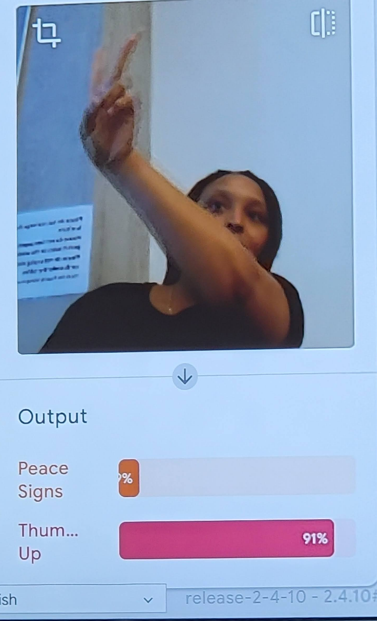
We’ve done several activities with ML today
Name the Reasoner:
Teachable Machines
Fishy Feature Space
Machine Learning for Kids
Candyland
Decision Trees

Slide 3
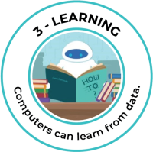
Machine Learning (ML)
How computers recognize patterns and make decisions without being explicitly programmed.
Supervised Learning
Goal: Learn the relationship between inputs and outputs so it can accurate predict the output for new, unseen data
Labeled Data
input - output pairs
Usage:
Classification & Prediction
Unsupervised Learning
Goal: Discover hidden patterns, structure, or relationships within data.
Unlabeled Data
No predefined outputs to learn from
Usage:
Clustering (Customer Segmentation)
Reinforcement Learning
Trial & Error Learning
Unlabeled Data
Usage: Game playing, robotics, and control systems
Notes:
1. Supervised Learning:
In supervised learning, the algorithm is trained on a labeled dataset, meaning the input data is paired with the correct output or target.
The goal is for the algorithm to learn the relationship between inputs and outputs so it can accurately predict the output for new, unseen data.
Examples include:
Classification: Categorizing data into predefined classes (e.g., spam or not spam).
Regression: Predicting a continuous value (e.g., house prices).
2. Unsupervised Learning:
Unsupervised learning algorithms work with unlabeled data, meaning they don't have predefined outputs to learn from.
The focus is on discovering hidden patterns, structures, or relationships within the data.
Examples include:
Clustering: Grouping similar data points together (e.g., customer segmentation).
Dimensionality reduction: Reducing the number of variables in the dataset while preserving important information.
3. Semi-Supervised Learning:
This approach combines elements of both supervised and unsupervised learning.
It uses a small amount of labeled data along with a larger amount of unlabeled data to train the model.
Semi-supervised learning can be useful when labeled data is scarce or expensive to obtain.

Slide 4
We’ve done several activities with ML today
Name the type of ML that created each reasoner
Candyland
Decision Trees
Fishy Feature Space
Machine Learning for Kids
Teachable Machines
Movies
(AI Lab)

Slide 5

Link

Slide 6
Building vs Using a Model
It’s important to know when the machine learning is being used and when the learning stops.
Building & Testing a Model
Use Model in an Application
MODEL CONSTRUCTION
DEPLOYED MODEL
Not Learning…
but may still be collecting data for future learning
Learning

Slide 7
Machine Learning Pipeline
ML pipelines organize the steps for building and deploying models into well-defined tasks:
Building Dataset
Training Model
Testing Model
Deploying Model
The ML pipeline is series of interconnected steps that transform raw data into a usable model, ensuring consistency and efficiency in model development and deployment.
Build Dataset
Train model
Test model
Deploy model

Slide 8
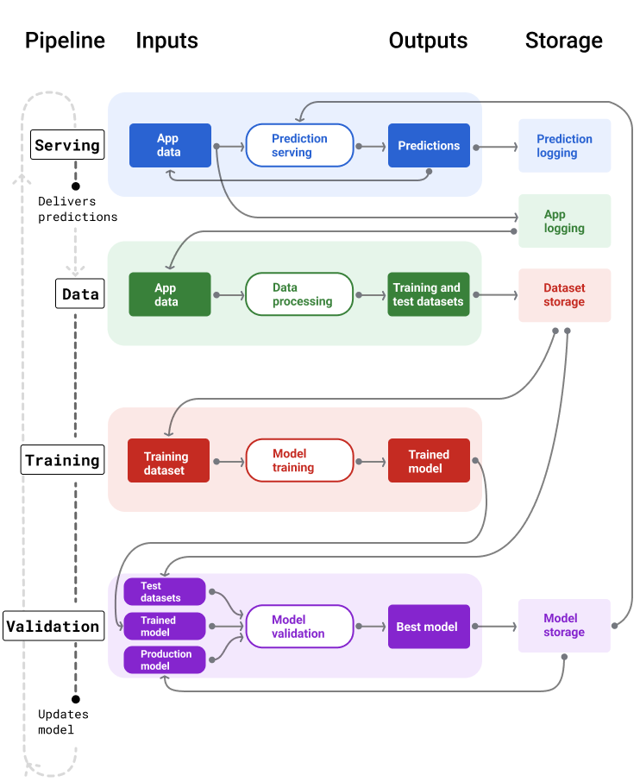
Real World
Machine Learning Pipeline
ML Pipelines have one of two functions:
Delivering predictions
(Deployed models)
Training or Updating the model (Constructing the model)
Notes:
Delivering predictions
The serving pipeline delivers predictions. It exposes your model to the real world, making it accessible to your users. For example, when a user wants a prediction—what the weather will be like tomorrow, or how many minutes it'll take to travel to the airport, or a list of recommended videos—the serving pipeline receives and processes the user's data, makes a prediction, and then delivers it to the user.
Updating the model
Models tend to go stale almost immediately after they go into production. In essence, they're making predictions using old information. Their training datasets captured the state of the world a day ago, or in some cases, an hour ago. Inevitably the world has changed: a user has watched more videos and needs a new list of recommendations; rain has caused traffic to slow and users need updated estimates for their arrival times; a popular trend causes retailers to request updated inventory predictions for certain items.
Typically, teams train new models well before the production model goes stale. In some cases, teams train and deploy new models daily in a continuous training and deployment cycle. Ideally, training a new model should happen well before the production model goes stale.

Slide 9
Pipelines Involved in
Training and Updating a Model
Almost all models go stale.
Some models go stale faster than others…
So we need an automated process for collecting updated data and using it to retrain our models

Slide 10
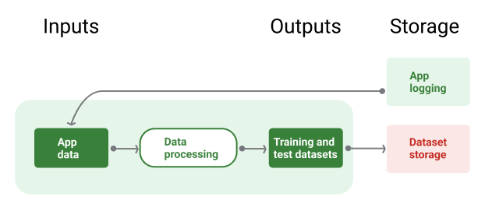
Data Pipeline
Figure 8. Data pipeline processes application data to create datasets for the training and validation pipelines.
Notes:
Source: https://developers.google.com/machine-learning/managing-ml-projects/pipelines#building_pipelines

Slide 11
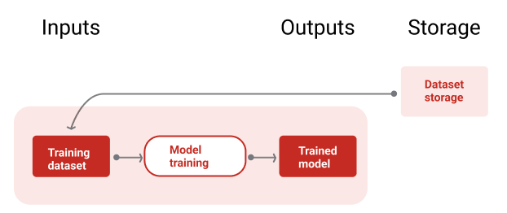
Training New Model Pipeline
Figure 9. The training pipeline trains new models using the most recent training dataset.
Notes:
After the model is trained, the validation pipeline uses test datasets to compare the production model's quality against the trained model.
In general, if the trained model isn't meaningfully worse than the production model, the trained model goes into production. If the trained model is worse, the monitoring infrastructure should create an alert. Trained models with worse prediction quality could indicate potential issues with the data or validation pipelines. This approach works to ensure the best model, trained on the freshest data, is always in production.

Slide 12
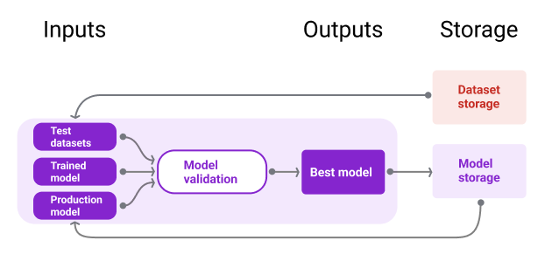
Validation Pipeline

Slide 13
Serving Pipeline
Model Storage
App
data
Prediction serving
Predictions
Prediction
logging

Slide 14
Real World
Machine Learning Pipeline
ML Pipelines have one of two functions:
Delivering predictions
(Deployed models)
Training or Updating the model (Constructing the model)
Notes:
Delivering predictions
The serving pipeline delivers predictions. It exposes your model to the real world, making it accessible to your users. For example, when a user wants a prediction—what the weather will be like tomorrow, or how many minutes it'll take to travel to the airport, or a list of recommended videos—the serving pipeline receives and processes the user's data, makes a prediction, and then delivers it to the user.
Updating the model
Models tend to go stale almost immediately after they go into production. In essence, they're making predictions using old information. Their training datasets captured the state of the world a day ago, or in some cases, an hour ago. Inevitably the world has changed: a user has watched more videos and needs a new list of recommendations; rain has caused traffic to slow and users need updated estimates for their arrival times; a popular trend causes retailers to request updated inventory predictions for certain items.
Typically, teams train new models well before the production model goes stale. In some cases, teams train and deploy new models daily in a continuous training and deployment cycle. Ideally, training a new model should happen well before the production model goes stale.

Slide 15
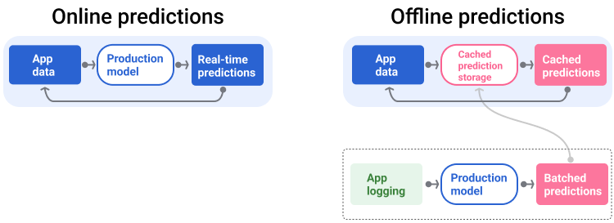
Serving Pipeline: Prediction Types
Notes:
Online predictions. Online predictions happen in real time, typically by sending a request to an online server and returning a prediction. For example, when a user wants a prediction, the user's data is sent to the model and the model returns the prediction.
Offline predictions. Offline predictions are precomputed and cached. To serve a prediction, the app finds the cached prediction in the database and returns it. For example, a subscription-based service might predict the churn rate for its subscribers. The model predicts the likelihood of churning for every subscriber and caches it. When the app needs the prediction—for instance, to incentive users who might be about to churn—it just looks up the precomputed prediction.

Slide 16
Examples: Living & Working with AI Curriculum

Slide 17
The Teachable Machine Pipeline
In Module 3.1, we used Code.org’s AI lab to create a dataset and trained a visual classifier for peace sign vs thumbs up
Build Dataset
Test
Identify the question
Identify the classes (labels)
Collect your data for each class
Train a classifier
Collect test data
If accuracy low
Use the model in a system
If accuracy is high
Test the model with users
If accuracy is high
Review Accuracy
Test the model

Slide 18
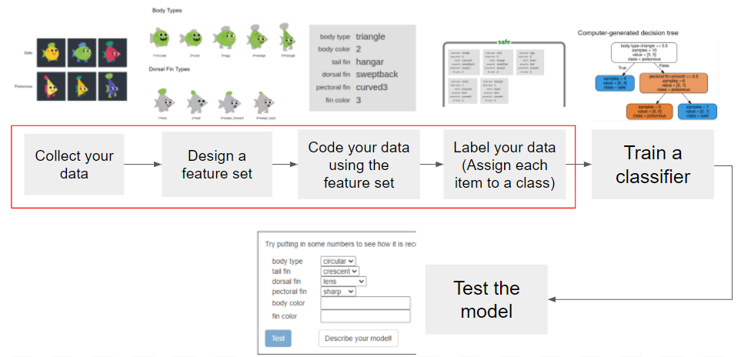
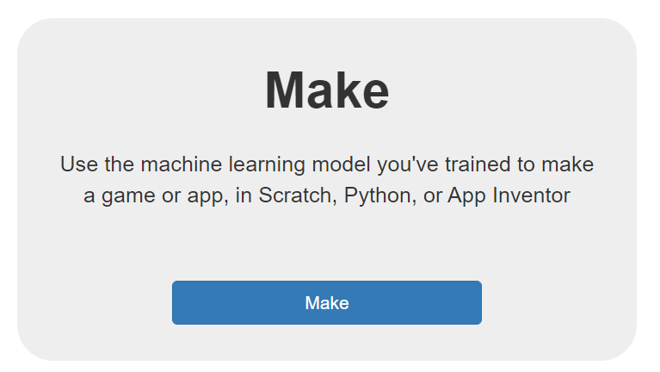
The ML4K Tool Pipeline
In Module 3.3, we used ML4K to create a fish classifier from numerical and text dataset
Build Dataset
If accuracy low
Use the model in a system

Slide 19
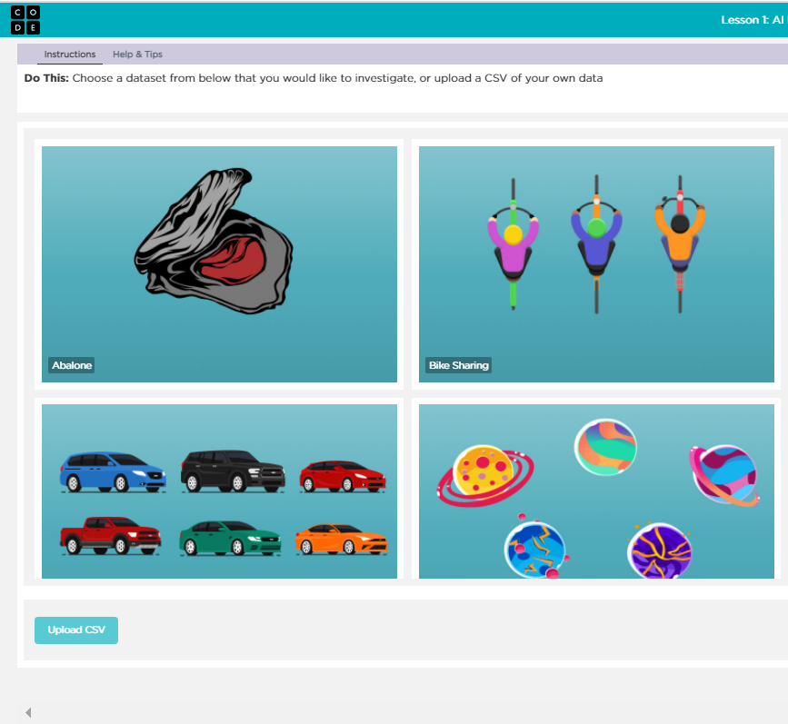
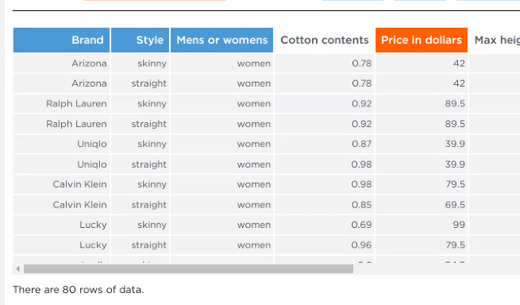
The AI Lab Machine Learning Pipeline
In Module 3.5, we used Code.org’s AI lab to create a predictive model from an existing dataset
Men’s or Women’s
Style
Brand
Cotton content
Size of pockets
What features best predict the price of jeans?
Price of Jeans
Build Dataset
Identify a dataset & review features
Identify a question
Select feature to predict
Select features that affect the feature to be predicted
Train a classifier
If accuracy low
Test
Use the model in a system
Test the model
Review Accuracy
Notes:
Teacher Note: This pipeline has a lot of similarities to the one we use for machine learning for kids. But it has several differences.
Step 1 - We don’t need to collect our own data because we have a datasets that others have already created for us. When we look at this data set we can see that there are already a number of features identified in the columns and the rows of the table are filled with examples.
Step 2 - So instead of defining features, we have to identify a question we want to answer with our data
Step 3- then we will select the feature we want to predict
Step 4 - then we will select the features we think will help us predict the feature we selected

Slide 20
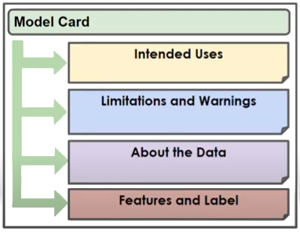
Model Card
Use model cards to document and share key information about your model, like its purpose, architecture, hardware requirements, evaluation metrics, etc.

Slide 21
Challenges Building Pipelines
Getting access to the data you need.
Getting the right features.
Understanding how the data is collected and represented.
Understanding the tradeoffs between effort, cost, and model quality.
Getting compute for retraining
Finding the right golden dataset (Maintaining consistent and accurate labels can be challenging for data that changes frequently)

